Slide 1
Module #11:
Sequences and Summations
26年 11月 8日
©2001-2004 Michael P. Frank, revised by S. Kang

Slide 2
§3.2: Sequences, Strings, & Summations
A sequence or series is just like an ordered n-tuple, except:
  Each element in the series has an associated index number.
  A sequence or series may be infinite.
A string is a sequence of symbols from some finite alphabet.
A summation is a compact notation for the sum of all terms in a (possibly infinite) series.
26年 11月 8日
©2001-2004 Michael P. Frank, revised by S. Kang

Slide 3
Sequences
A sequence or series {a_{n}} is identified with a generating function f:S→A for some subset S⊆N and for some set A.
  Often we have S=N or S=Z⁺=N−{0}.
If f is a generating function for a series {a_{n}}, then for n∈S, the symbol a_{n} denotes f(n), also called term n of the sequence.
  The index of a_{n} is n. (Or, often i is used.)
A series is sometimes denoted by listing its first and/or last few elements, and using ellipsis (…) notation.
  E.g., “{a_{n}} = 0, 1, 4, 9, 16, 25, …” is taken to mean
  ∀n∈N, a_{n} = n².
26年 11月 8日
©2001-2004 Michael P. Frank, revised by S. Kang

Slide 4
Sequence Examples
Some authors write “the sequence a₁, a₂, …” instead of {a_{n}}, to ensure that the set of indices is clear.
  Be careful: Our book often leaves the indices ambiguous.
An example of an infinite series:
  Consider the series {a_{n}} = a₁, a₂, …, where (∀n≥1) a_{n}= f(n) = 1/n.
  Then, we have {a_{n}} = 1, 1/2, 1/3, …
26年 11月 8日
©2001-2004 Michael P. Frank, revised by S. Kang

Slide 5
Example with Repetitions
Like tuples, but unlike sets, a sequence may contain repeated instances of an element.
Consider the sequence {b_{n}} = b₀, b₁, … (note that 0 is an index) where b_{n} = (−1)^{n}.
  Thus, {b_{n}} = 1, −1, 1, −1, …
    Note repetitions!
  This {b_{n}} denotes an infinite sequence of 1’s and −1’s, not the 2-element set {1, −1}.
26年 11月 8日
©2001-2004 Michael P. Frank, revised by S. Kang

Slide 6
Recognizing Sequences
Sometimes, you’re given the first few terms of a sequence,
  and you are asked to find the sequence’s generating function,
  or a procedure to enumerate the sequence.
Examples: What’s the next number?
  1,2,3,4,…
  1,3,5,7,9,…
  2,3,5,7,11,...
5 (the 5th smallest number >0)
11 (the 6th smallest odd number >0)
13 (the 6th smallest prime number)
26年 11月 8日
©2001-2004 Michael P. Frank, revised by S. Kang

Slide 7
The Trouble with Sequence Recognition
As you know, these problems are popular on IQ tests, but…
The problem of finding “the” generating function given just an initial subsequence is not a mathematically well defined problem.
  This is because there are infinitely many computable functions that will generate any given initial subsequence.
We implicitly are supposed to find the simplest such function (because this one is assumed to be most likely), but,
  how are we to objectively define the simplicity of a function?
We might define simplicity as the reciprocal of complexity, but…
  There are many different plausible, competing definitions of complexity, and this is an active research area.
So, these questions really have no objective right answer!
  Still, we will ask you to answer them anyway… (Because others will too.)
26年 11月 8日
©2001-2004 Michael P. Frank, revised by S. Kang

Slide 8
What are Strings, Really?
This book says “finite sequences of the form
a₁, a₂, …, a_{n} are called strings”,
  but infinite strings are also discussed sometimes.
Strings are normally restricted to sequences composed of symbols drawn from a finite alphabet, and are often indexed from 0 or 1.
  But these are really arbitrary restrictions also.
Either way, the length of a (finite) string is just its number of terms (or of distinct indices).
26年 11月 8日
©2001-2004 Michael P. Frank, revised by S. Kang

Slide 9
Strings, more formally
Let Σ be a finite set of symbols, i.e. an alphabet.
  A string s over alphabet Σ is any sequence {s_{i}} of symbols, s_{i}∈Σ, normally indexed by N or N−{0}.
If a, b, c, … are symbols, the string s = a, b, c, … can also be written abc…(i.e., without commas).
If s is a finite string and t is any string, then the concatenation of s with t, written just st,
  is simply the string consisting of the symbols in s, in sequence, followed by the symbols in t, in sequence.
26年 11月 8日
©2001-2004 Michael P. Frank, revised by S. Kang

Slide 10
More Common String Notations
The length |s| of a finite string s is its number of
positions (i.e., its number of index values i).
If s is a finite string and n∈N,
  Then s^{n} denotes the concatenation of n copies of s.
ε or “” denotes the empty string, the string of length 0.
  This is fairly common, but the book uses λ instead.
If Σ is an alphabet and n∈N,
Σ^{n} :≡ {s | s is a string over Σ of length n}, and
Σ* :≡ {s | s is a finite string over Σ}.
26年 11月 8日
©2001-2004 Michael P. Frank, revised by S. Kang

Slide 11
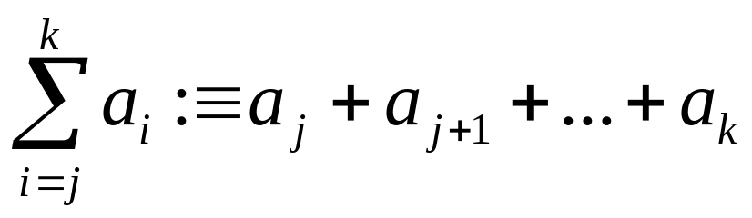
Summation Notation
Given a series {a_{n}}, an integer lower bound (or limit) j≥0, and an integer upper bound k≥j, then the summation of {a_{n}} from j to k is written and defined as follows:
Here, i is called the index of summation.
26年 11月 8日
©2001-2004 Michael P. Frank, revised by S. Kang

Slide 12
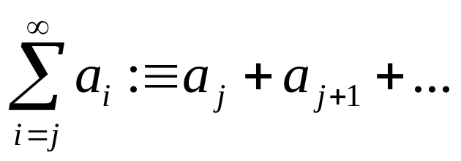
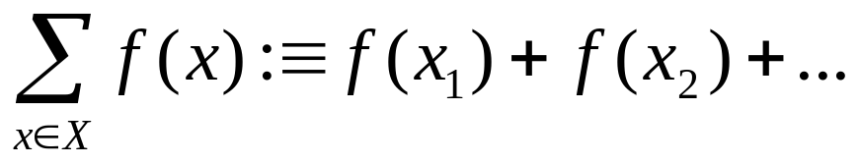
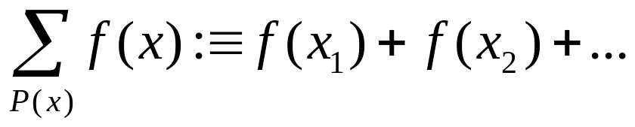
Generalized Summations
For an infinite series, we may write:
To sum a function over all members of a set X={x₁, x₂, …}:
Or, if X={x|P(x)}, we may just write:
26年 11月 8日
©2001-2004 Michael P. Frank, revised by S. Kang

Slide 13
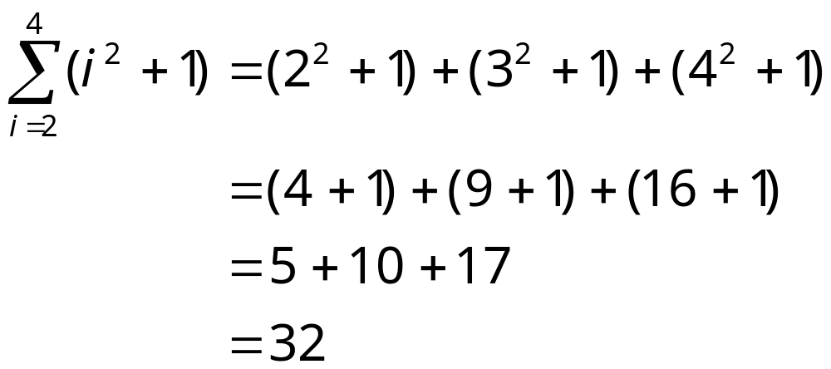
Simple Summation Example
26年 11月 8日
©2001-2004 Michael P. Frank, revised by S. Kang

Slide 14
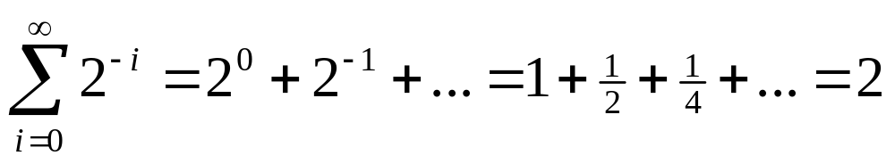
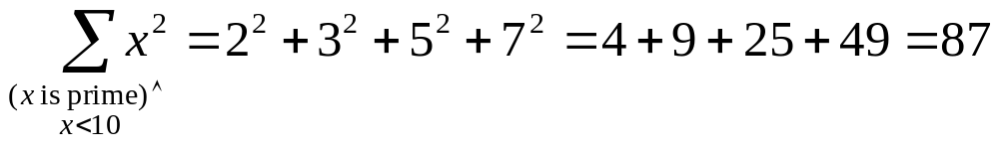
More Summation Examples
An infinite series with a finite sum:
Using a predicate to define a set of elements to sum over:
26年 11月 8日
©2001-2004 Michael P. Frank, revised by S. Kang

Slide 15
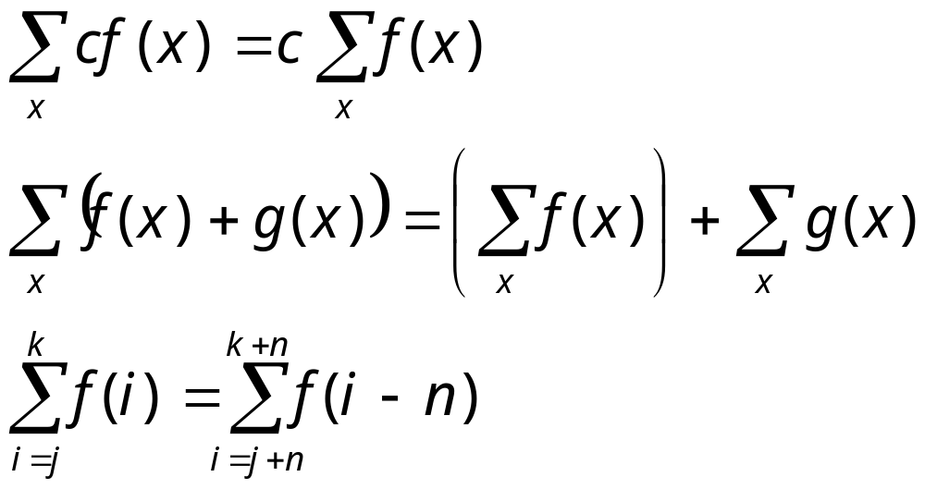
Summation Manipulations
Some handy identities for summations:
(Distributive law.)
(An application
of commut-
ativity.)
(Index shifting.)
26年 11月 8日
©2001-2004 Michael P. Frank, revised by S. Kang

Slide 16
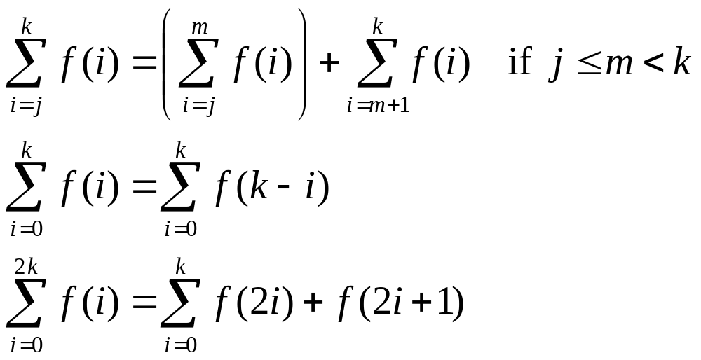
More Summation Manipulations
Other identities that are sometimes useful:
(Series splitting.)
(Order reversal.)
(Grouping.)
26年 11月 8日
©2001-2004 Michael P. Frank, revised by S. Kang

Slide 17
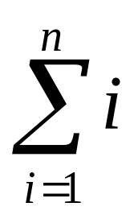
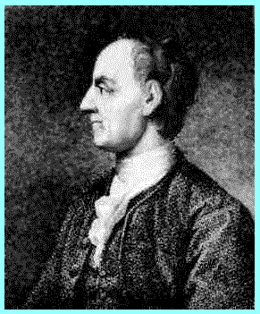
Example
“Add all the numbers from 1 to n in just a few seconds.”
I.e., Evaluate the summation:
There is a simple closed-form formula for the result, discovered by Euler at age 12!
  And frequently rediscovered by many…
Leonhard
Euler
(1707-1783)
26年 11月 8日
©2001-2004 Michael P. Frank, revised by S. Kang

Slide 18
Euler’s Trick, Illustrated
Consider the sum:
1+2+…+(n/2)+((n/2)+1)+…+(n-1)+n
We have n/2 pairs of elements, each pair summing to n+1, for a total of (n/2)(n+1).
n+1
…
n+1
n+1
26年 11月 8日
©2001-2004 Michael P. Frank, revised by S. Kang

Slide 19
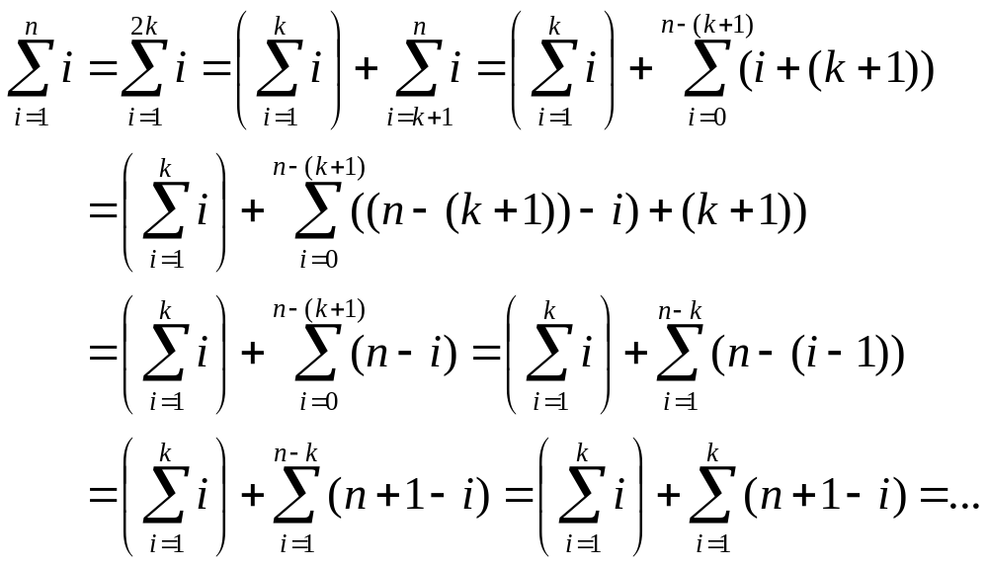
Symbolic Derivation of Trick
For case where n is even…
26年 11月 8日
©2001-2004 Michael P. Frank, revised by S. Kang

Slide 20
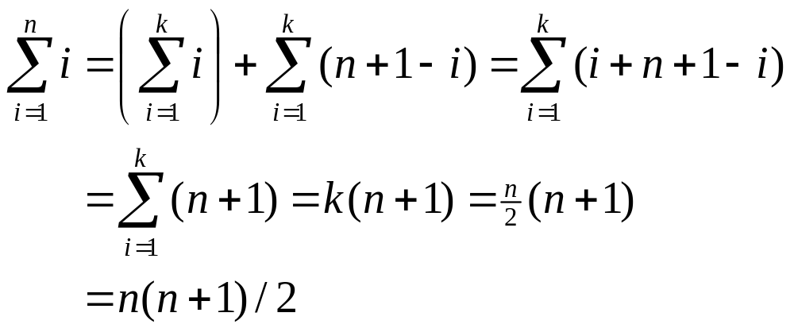
Concluding Euler’s Derivation
So, you only have to do 1 easy multiplication in your head, then cut in half.
Also works for odd n (prove this at home).
26年 11月 8日
©2001-2004 Michael P. Frank, revised by S. Kang

Slide 21
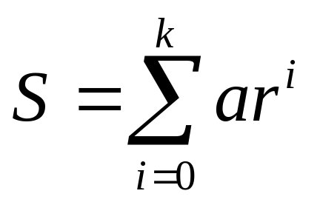
Example: Geometric Progression
A geometric progression is a series of the form a, ar, ar², ar³, …, ar^{k}, where a,r∈R.
The sum of such a series is given by:
We can reduce this to closed form via clever manipulation of summations...
26年 11月 8日
©2001-2004 Michael P. Frank, revised by S. Kang

Slide 22
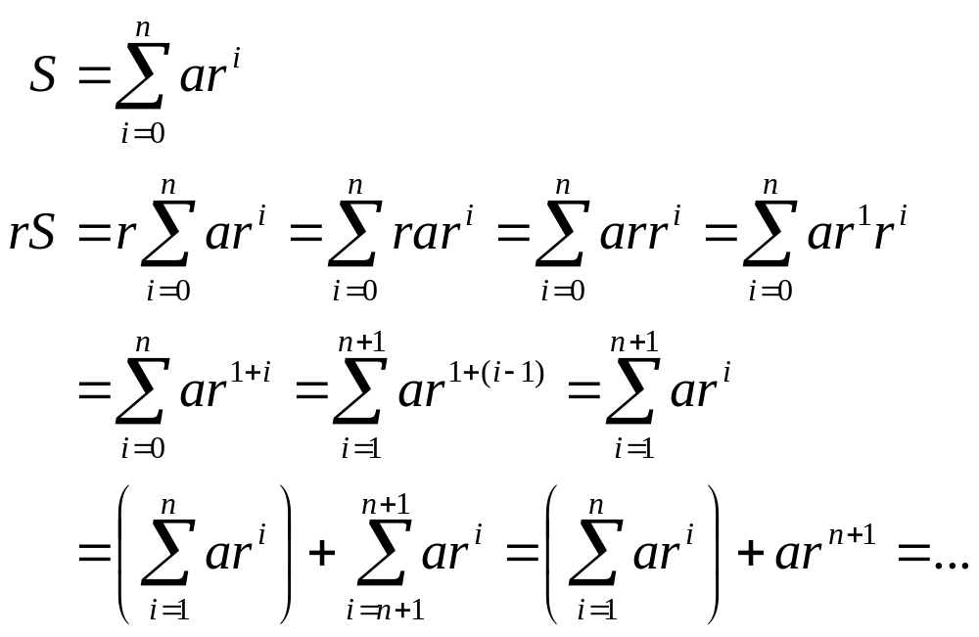
Geometric Sum Derivation
Here
we
go...
26年 11月 8日
©2001-2004 Michael P. Frank, revised by S. Kang

Slide 23
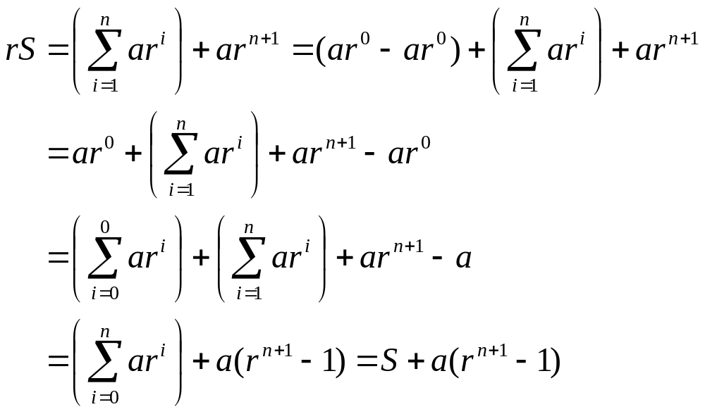
Derivation example cont...
26年 11月 8日
©2001-2004 Michael P. Frank, revised by S. Kang

Slide 24
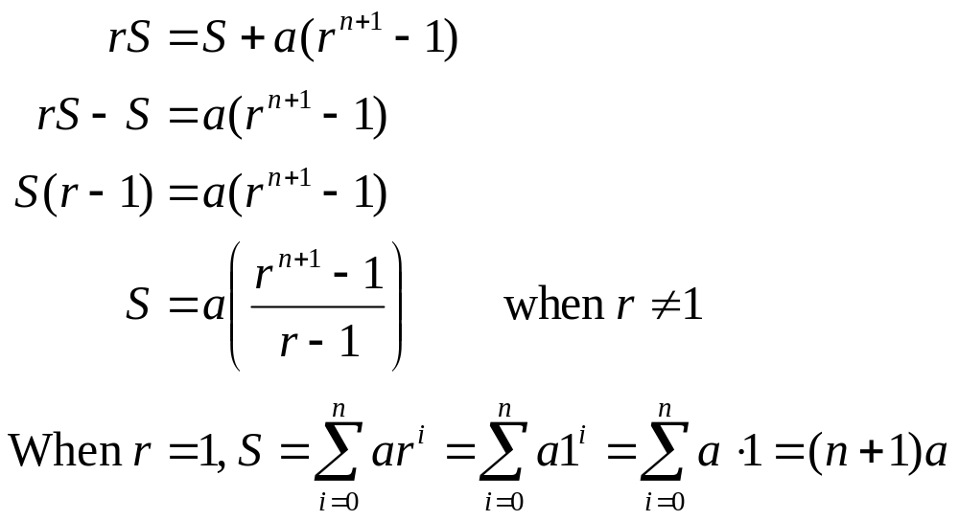
Concluding long derivation...
26年 11月 8日
©2001-2004 Michael P. Frank, revised by S. Kang

Slide 25
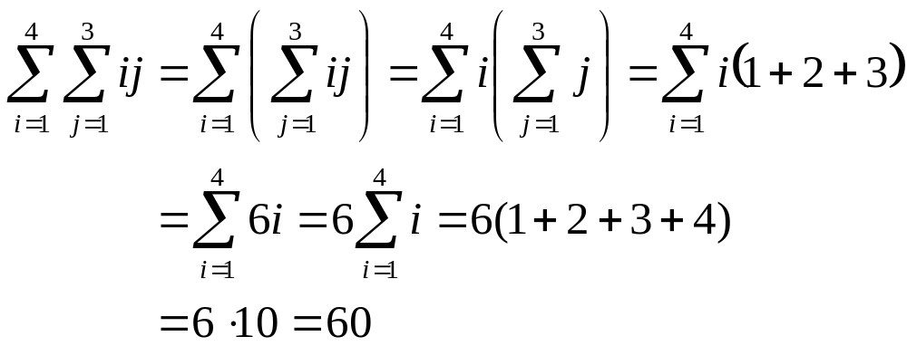
Nested Summations
These have the meaning you’d expect.
Note issues of free vs. bound variables, just like in quantified expressions, integrals, etc.
26年 11月 8日
©2001-2004 Michael P. Frank, revised by S. Kang

Slide 26
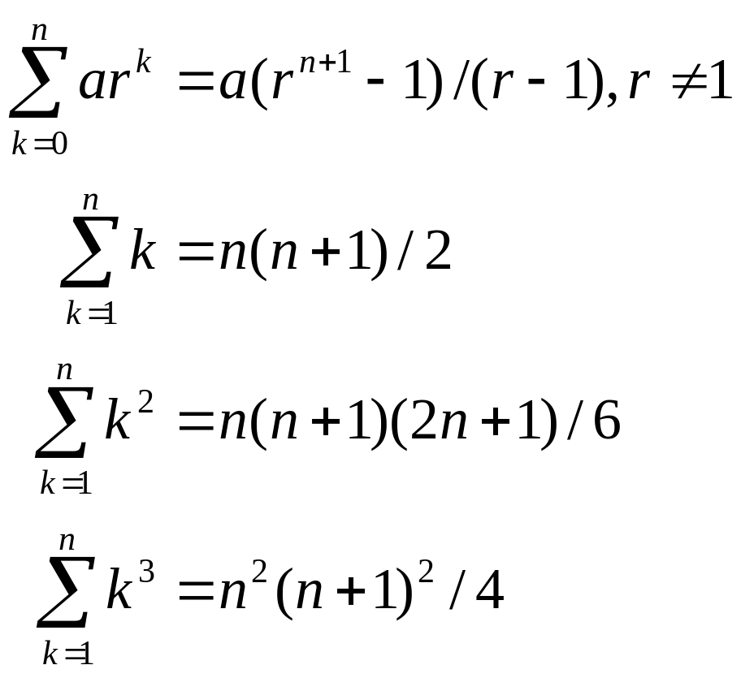
Some Shortcut Expressions
Geometric series.
Euler’s trick.
Quadratic series.
Cubic series.
26年 11月 8日
©2001-2004 Michael P. Frank, revised by S. Kang

Slide 27
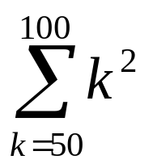
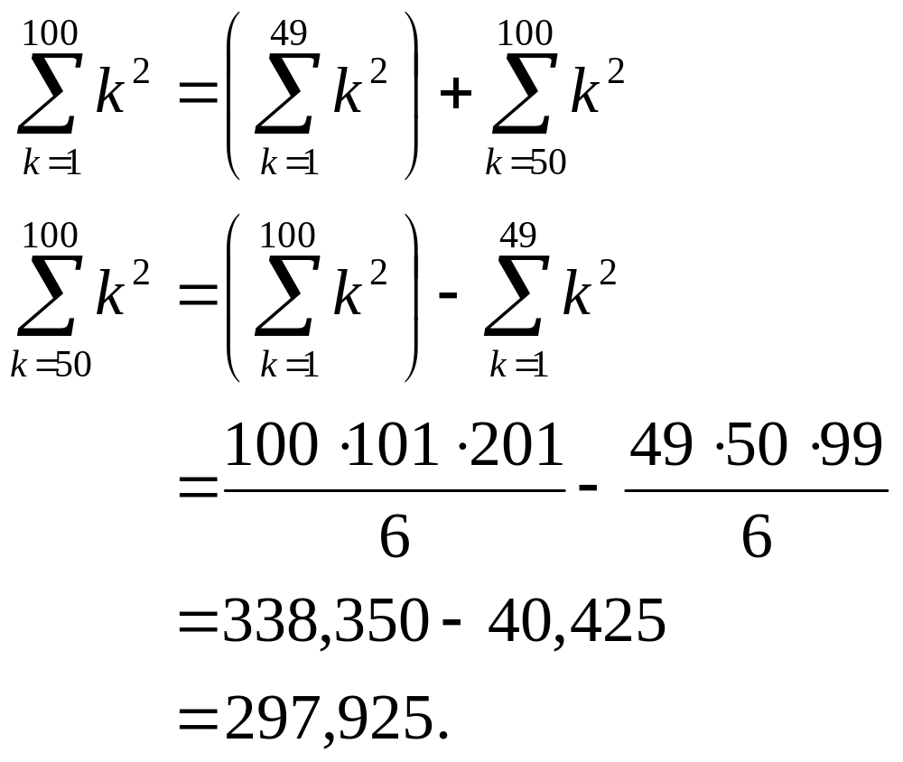
Using the Shortcuts
Example: Evaluate .
  Use series splitting.
  Solve for desired
  summation.
  Apply quadratic
  series rule.
  Evaluate.
26年 11月 8日
©2001-2004 Michael P. Frank, revised by S. Kang

Slide 28
Infinite Cardinalities
Using what we learned about functions in §1.8, it’s possible to formally define cardinality even for infinite sets.
We can also show that infinite sets come in
different sizes of infinite!
This also gives us some interesting proof examples.
26年 11月 8日
©2001-2004 Michael P. Frank, revised by S. Kang

Slide 29
Cardinality: Formal Definition
For any two (possibly infinite) sets A and B, we say that A and B have the same cardinality (written |A|=|B|) iff there exists a bijection (bijective function) from A to B.
When A and B are finite, it is easy to see that such a function exists iff A and B have the same number of elements n∈N.
26年 11月 8日
©2001-2004 Michael P. Frank, revised by S. Kang

Slide 30
Countable versus Uncountable
For any set S, if S is finite or if |S|=|N|, we say S is countable. Else, S is uncountable.
Intuition behind “countable:” we can enumerate (sequentially list) elements of S in such a way that any individual element of S will eventually be counted in the enumeration. Examples: N, Z.
Uncountable means: No series of elements of S (even an infinite series) can include all of S’s elements. Example: R
26年 11月 8日
©2001-2004 Michael P. Frank, revised by S. Kang

Slide 31
Countable Sets: Examples
Theorem: The set Z is countable.
  Proof: Consider f:Z→N where f(i)=2i for i≥0 and f(i) = −2i−1 for i<0. Note f is bijective.
Theorem: The set of all ordered pairs of natural numbers (n,m) is countable.
  Consider listing the pairs in order by their sum s=n+m, then by n. Every pair appears once in this series; the generatin
Theorem: The set Q (Rational) is countable.
26年 11月 8日
©2001-2004 Michael P. Frank, revised by S. Kang

Slide 32
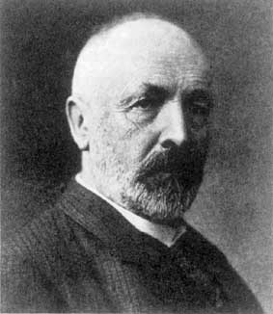
Uncountable Sets: Example
Theorem: The open interval of reals
[0,1) :≡ {r∈R| 0 ≤ r < 1} is uncountable.
Proof by diagonalization: (Cantor, 1891)
  Assume there is a series {r_{i}} = r₁, r₂, ... containing all elements r∈[0,1).
  Consider listing the elements of {r_{i}} in decimal notation (although any base will do) in order of increasing index: ... (continued on next slide)
Georg Cantor
1845-1918
26年 11月 8日
©2001-2004 Michael P. Frank, revised by S. Kang

Slide 33
Uncountability of Reals, cont’d
A postulated enumeration of the reals:
r₁ = 0.d_{1,1} d_{1,2} d_{1,3} d_{1,4} d_{1,5} d_{1,6} d_{1,7} d_{1,8}…
r₂ = 0.d_{2,1} d_{2,2} d_{2,3} d_{2,4} d_{2,5} d_{2,6} d_{2,7} d_{2,8}…
r₃ = 0.d_{3,1} d_{3,2} d_{3,3} d_{3,4} d_{3,5} d_{3,6} d_{3,7} d_{3,8}…
r₄ = 0.d_{4,1} d_{4,2} d_{4,3} d_{4,4} d_{4,5} d_{4,6} d_{4,7} d_{4,8}…
Now, consider a real number generated by taking
all the digits d_{i,i} that lie along the diagonal in this figure and replacing them with different digits.
That real doesn't appear in the list!
26年 11月 8日
©2001-2004 Michael P. Frank, revised by S. Kang
Notes:
Discrete Mathematics and its Applications
26年 11月 8日
(c)2001-2002, Michael P. Frank

Slide 34
Uncountability of Reals, fin.
E.g., a postulated enumeration of the reals:
r₁ = 0.301948571…
r₂ = 0.103918481…
r₃ = 0.039194193…
r₄ = 0.918237461…
OK, now let’s add 1 to each of the diagonal digits (mod 10), that is changing 9’s to 0.
  0.4103… can’t be on the list anywhere!
26年 11月 8日
©2001-2004 Michael P. Frank, revised by S. Kang

